Slide 1
Link Analysis I Ranking of Vertices in Graphs PageRank

Slide 2
Web - page score
Query Dependent Score
- page content – query words
Query Independent Score
- link structure /relationship

Slide 3
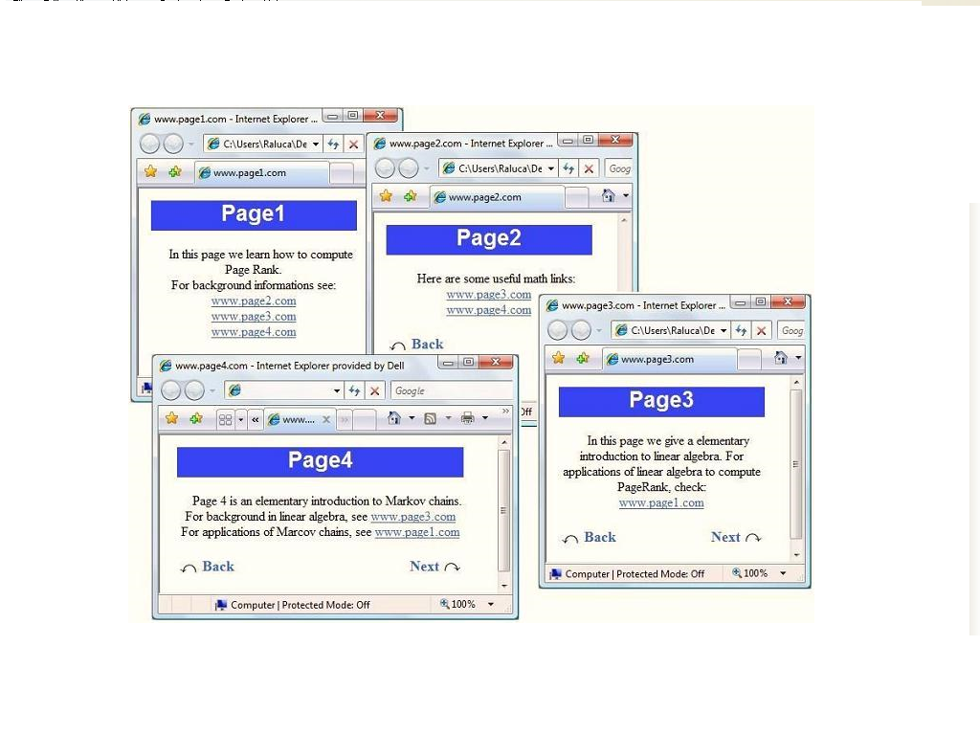
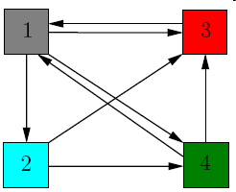
Web as a graph
Each page/document on the Web is represented as a node in a very large graph.
The directed arcs connecting these nodes represent the hyperlinks between the documents.

Slide 4
Graph-based Ranking
Web graph
Social Network
Web Page 1
Person 1
Web Page 2
Person 2
Gene 1
Biological network
Gene 2
A graph-based ranking algorithm is a way of deciding on the importance of a vertex within a graph

Slide 5
Web Search
The analysis of hyperlinks and the graph structure of the Web has been instrumental in the development of web search
Link analysis is one of many factors considered by web search engines in computing a score for a web page on any given query – query independent score.

Slide 6
PageRank – Main idea
It is a graph (Link) based ranking technique, used by Google
PageRank interprets a hyperlink from page x to page y as a vote, by page x, for page y.
A page is important if it is pointed to by many other important pages
X
Y

Slide 7
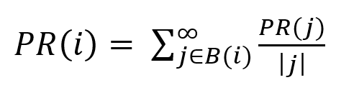


PageRank – The original summation method
PR(i) – Page Rank of a node
B(i) - Set of all pages that point to page ‘i’
| j | - The number of out links of Page j

Slide 8
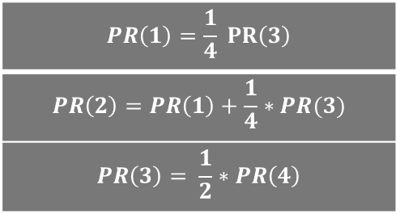
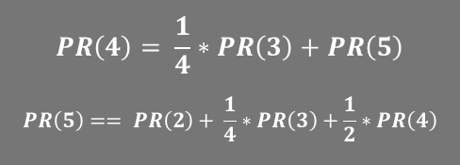
PageRank – Tiny Web
$$PR\left(1\right)=\frac{1}{4} PR\left(3\right)$$
$$PR\left(2\right)=PR\left(1\right)+\frac{1}{4}∗PR(3)$$
$$PR\left(3\right)= \frac{1}{2}∗PR\left(4\right)$$
$$PR\left(4\right)= \frac{1}{4}∗PR\left(3\right)+PR\left(5\right)$$
$$PR\left(5\right)== PR\left(2\right)+ \frac{1}{4}∗PR\left(3\right)+\frac{1}{2}∗PR\left(4\right)$$
 | Iteration 0 | Iteration 1 | Iteration 2 | Page Rank
1 | 1/5 | 1/20 | 1/40 | 5
2 | 1/5 | 5/20 | 3/40 | 4
3 | 1/5 | 1/10 | 5/40 | 3
4 | 1/5 | 5/20 | 15/40 | 2
5 | 1/5 | 7/20 | 16/40 | 1

Slide 9
Matrix Notation
 | 1 | 2 | 3 | 4 | 5
1 | 0 | 1 | 0 | 0 | 0
2 | 0 | 0 | 0 | 0 | 1
3 | 1 | 1 | 0 | 1 | 1
4 | 0 | 0 | 1 | 0 | 1
5 | 0 | 0 | 0 | 1 | 0
Adjacence matrix
 | 1 | 2 | 3 | 4 | 5
1 | 0 | 1 | 0 | 0 | 0
2 | 0 | 0 | 0 | 0 | 1
3 | 1/4 | 1/4 | 0 | 1/4 | 1/4
4 | 0 | 0 | 1/2 | 0 | 1/2
5 | 0 | 0 | 0 | 1 | 0
Hyperlink matrix
Hij = 1 / │Pi │if there is a link from node i to node j,
= 0 otherwise

Slide 10
Matrix Notation
Let pr be a n-dimensional vector of PageRank values, i.e., pr = (pr(1), pr(2), …, pr(n))^{T.}
 | 1 | 2 | 3 | 4 | 5
1 | 0 | 1 | 0 | 0 | 0
2 | 0 | 0 | 0 | 0 | 1
3 | 1/4 | 1/4 | 0 | 1/4 | 1/4
4 | 0 | 0 | 1/2 | 0 | 1/2
5 | 0 | 0 | 0 | 1 | 0
= [ 1/5 1/5 1/5 1/5 1/5]
[1/20 5/20 1/10 5/20 7/20]
pr^{(k+1)T} = pr^{(k)T} H

Slide 11
Four questions
pr ^{(k+1)T} = pr ^{(k)T} H
Does this converge?
Under what circumstances it is guaranteed to converge?
Is the vector to which it converges independent of the initial vector?
Does it converge to what we want?

Slide 12


Random walks in graphs
Adjacency matrix A
Transition matrix P
B
B
1
1
A
1
1/2
1
1
A
1
C
1/2
C

Slide 13

What is a random walk?
t=0
1
1/2
1
1/2

Slide 14
What is a random walk
t=0
t=1
1
1
1/2
1/2
1
1
1/2
1/2

Slide 15

What is a random walk
t=0
t=1
1
1
1/2
1/2
1
1
1/2
1/2
t=2
1
1/2
1
1/2

Slide 16


What is a random walk
t=0
t=1
1
1
1/2
1/2
1
1
1/2
1/2
t=2
t=3
1
1/2
1
1
1/2
1
1/2
1/2

Slide 17
Random Surfer model
Imagine a web surfer who crawls the web by randomly following the hyper link structure of the web.
When he arrives at a page with several out links, chooses one at random and hyper links to the page.
In the long run, the proportion of time the surfer spends on the page is measure of the importance of the page.
When he often visits a node, he spends large proportion of time on that node.
Such a node is pointed to by other important nodes.

Slide 18
Random Surfer Model
The random surfing on web graph can be modeled as a Markov Chain where the next state depends on the current state and all transitions are equally probable

Slide 19
Stationary probability distribution?
By a Theorem of the Markov chain,
Markov chain defined by the stochastic matrix H has a unique stationary probability distribution if it is irreducible and aperiodic.
The stationary probability distribution means that after a series of transitions pr ^{k} will converge to a steady-state probability vector , regardless of the choice of the initial probability vector p0, i.e.,
lim pr^{k} = π
k→∞

Slide 20
Make H as Stochastic matrix (to fix dangling nodes)
 | 1 | 2 | 3 | 4 | 5
1 | 0 | 1 | 0 | 0 | 0
2 | 1/5 | 1/5 | 1/5 | 1/5 | 1/5
3 | 1/4 | 1/4 | 0 | 1/4 | 1/4
4 | 0 | 0 | 1/2 | 0 | 1/2
5 | 0 | 0 | 0 | 1 | 0
Dangling
node
where A is a matrix whose entries
are all zero except for the rows
corresponding to dangling nodes
S = H + A
S is stochastic

Slide 21
To make S as primitive
Consider a random surfer that starts from a random page, and at every time
chooses the next page by clicking on one of the links in the current page (selected uniformly at random among the links present in the page) or
Jumps to a random page, when he gets bored of the hyper links available in the page

Slide 22
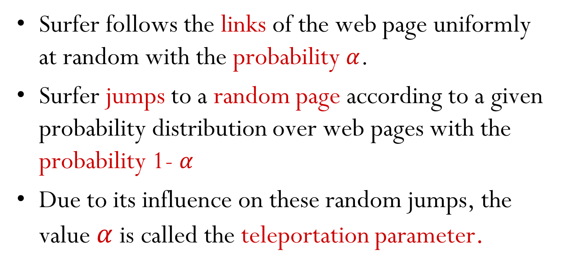
To make S as primitive
Surfer follows the links of the web page uniformly at random with the probability $α$.
Surfer jumps to a random page according to a given probability distribution over web pages with the probability 1- $α$
Due to its influence on these random jumps, the value $α$ is called the teleportation parameter.

Slide 23
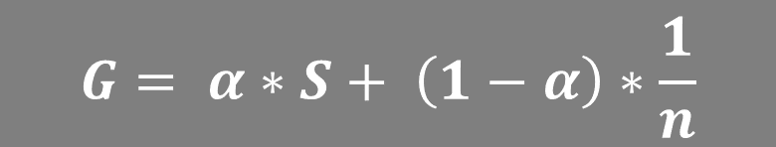
Final modification to S
$$G= α∗S+ \left(1−α\right)∗\frac{1}{n}$$
Every page is connected to every other page, G is irreducible
Self loops create aperiodicity, G_{ii} >0 for all i
So G converges

Slide 24
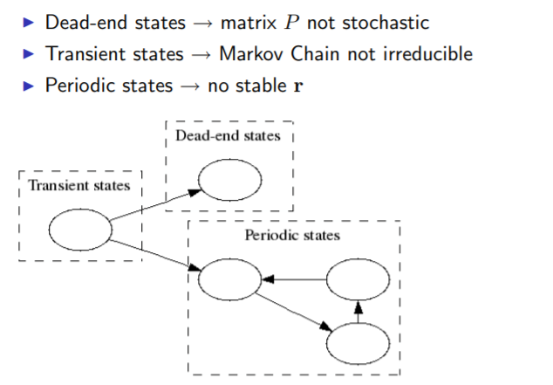

Slide 25
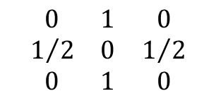
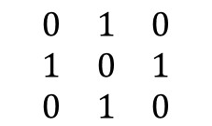
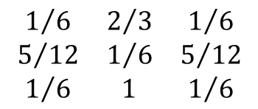
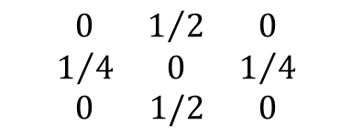
Consider a web graph with three nodes 1, 2 and 3. The links are as follows: 1 → 2, 3 → 2, 2 → 1, 2 → 3. (α = 0.5).
If a row of A has no 1’s, then replace each element by 1/N. For all other rows proceed as follows.
Divide each 1 in A by the number of 1’s in its row.
Multiply the resulting matrix by 1 − α.
Add α/N to every entry of the resulting matrix, to obtain P.
1
3
2
1. Adjacency(A)
2. Hyperlink (H)
3. Modified Hyperlink(S)
$$\begin{matrix}0 & 1 & 0 \\ 1 & 0 & 1 \\ 0 & 1 & 0\end{matrix}$$
$$\begin{matrix}0 & 1 & 0 \\ 1/2 & 0 & 1/2 \\ 0 & 1 & 0\end{matrix}$$
$$\begin{matrix}0 & 1/2 & 0 \\ 1/4 & 0 & 1/4 \\ 0 & 1/2 & 0\end{matrix}$$
$$\begin{matrix}1/6 & 2/3 & 1/6 \\ 5/{12} & 1/6 & 5/{12} \\ 1/6 & 1 & 1/6\end{matrix}$$
4. Final TPM (G)

Slide 26
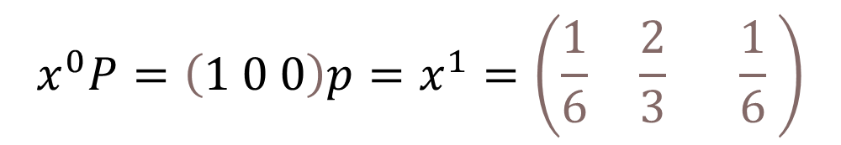

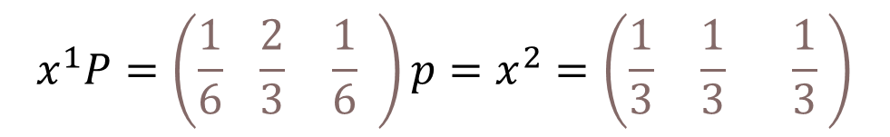
$$\left.x^{0} ( =1 0 0\right)$$
$$x^{0}P=\left(1 0 0\right)p=x^{1}=\left(\frac{1}{6} \frac{2}{3} \frac{1}{6} \right)$$
$$x^{1}P=\left(\frac{1}{6} \frac{2}{3} \frac{1}{6} \right)p=x^{2}=\left(\frac{1}{3} \frac{1}{3} \frac{1}{3} \right)$$
X = (5/18 4/9 5/18).

Slide 27
Thank You

